Slide 1

ADVANCED INTELLIGENT TOURIST GUIDE -> Explore the world with advanced intelligence
PROJECT GUIDE :
G. RAMADEVI MAM
A. DHANUSH - 211801360004
K. Manohar – 211801390034
v. Harshith – 211801390035
y. Narayanarao – 211801340008
e. Ayyappa - 211801340018

Slide 2
abstract
An advanced intelligent tourist guide is an AI-based system designed to provide personalized recommendations and guidance to tourists during their travels.
The system uses machine learning algorithms and natural language processing to understand the preferences and interests of individual users and suggest relevant activities, attractions, and services based on their location, schedule, and budget.
It can also assist with itinerary planning, booking, and real-time navigation, making it a valuable tool for both independent and group travelers.
With the ability to learn from user feedback and improve over time, an advanced intelligent tourist guide has the potential to revolutionize the tourism industry and enhance the overall travel experience for millions of people worldwide.

Slide 3
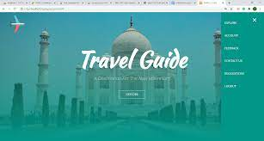
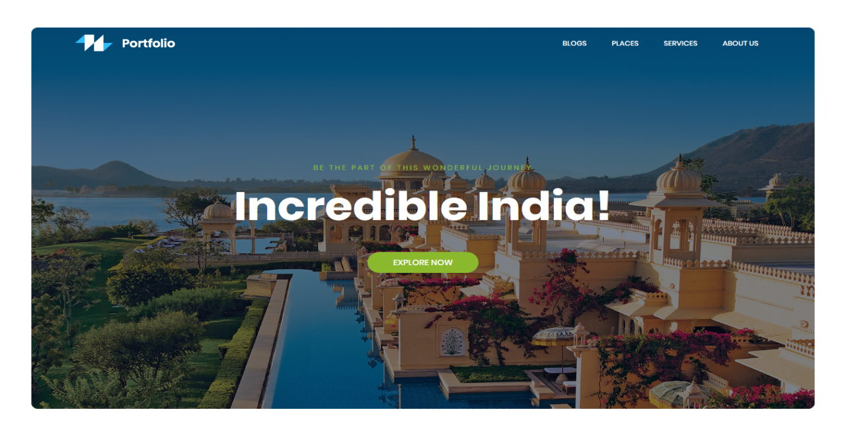
introduction
The concept of an advanced intelligent tourist guide is not new, but recent advancements in technology have made it more feasible than ever before.
This type of guide would use artificial intelligence and machine learning to provide personalized recommendations and insights to travelers.
Imagine having a virtual assistant that can help you plan your trip, suggest the best places to visit based on your interests, and even make reservations for you.
This is the future of travel, and it’s closer than you might think.
The benefits of an Advanced intelligent tourist guide is that it would save travelers time and effort.
Instead of spending hours researching and planning their trip, they could simply input their preferences into the system and receive personalized recommendations.
The system would be able to provide recommendations based on real-time data.
If there is a suddeen change in whether or a new attraction opens up the system would be able to update its recommendations accordingly.

Slide 4
EXISTING SYSTEM
In the current system, a user must contact several authorities in order to obtain information on specific locations . After that, the user can examine package details before booking tickets.
This sometimes takes a lot of time and effort because he or she must first signup/signin before being able to examine package details.
These pages may not provide the information that the user seeks, and the user may be misled as a result. Each operation is completed by hand, and processing is a time-consuming procedure. Previously, travelers had to manually record time table information on paper, which was both time consuming and costly.

Slide 5
DISADVANTAGES
Limited Accuracy
Use by Criminals
Irrelevant Content
Too Slow to load

Slide 6
PROPOSED SYSTEM
In the proposed system, “planned time to return” is also considered at the time of the use. In this way, this system can propose a sightseeing route and sightseeing plan that it can guide that used present time from time to return time automatically.
The system automatically searches for places of interest around the location.
So , the traveler will not miss out on any attractions which he is unaware of. The interests and preferences of the user is also considered and the places are chosen accordingly. In this application system, we make a list of sightseeing information according to sightseeing categories. In the result, we display both guidance routes on the map and guidance routes by text.
The application displays a menu with the main categories of attractions available in the city, by clicking on one of the categories all the related information is displayed.

Slide 7
ADVANATGES
Gives accurate information.
Simplifies the manual work.
It minimizes the documentation related work.
Provides up to date information.
Friendly Environment by providing warning messages.
Travelers details can be provided.
Booking confirmation notification.

Slide 8
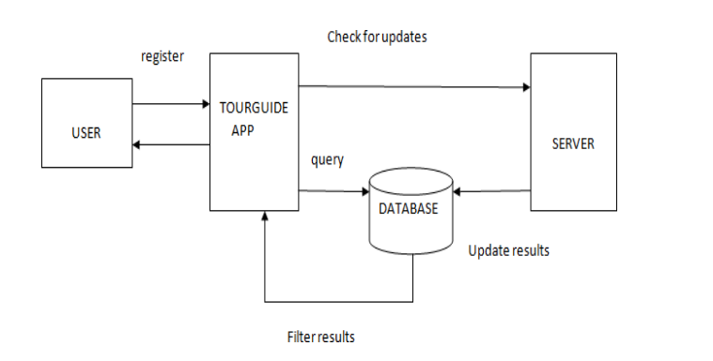
SYSTEM ARCHITECTURE

Slide 9
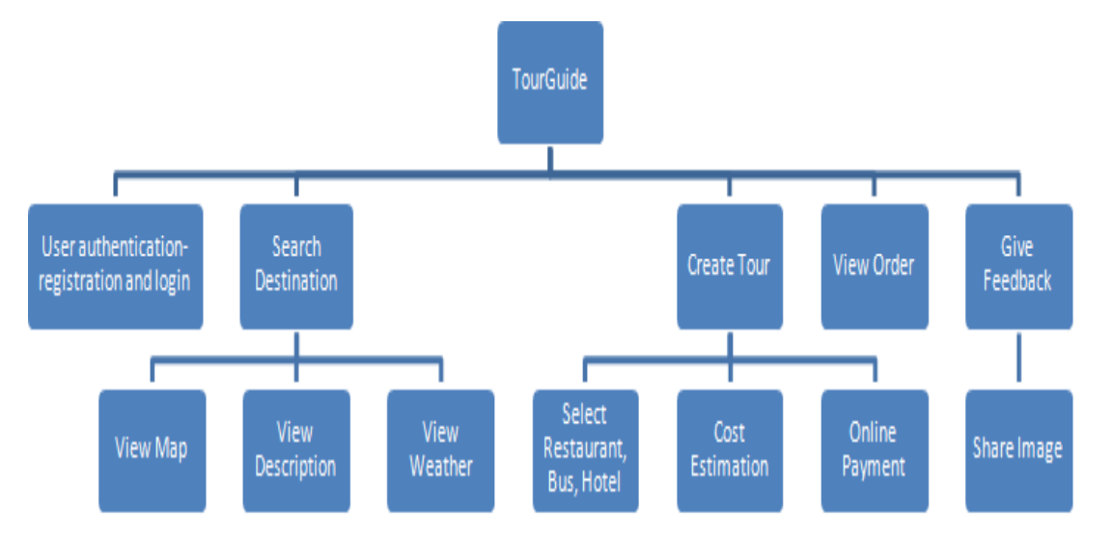
METHODOLOGY

Slide 10
The Management Application is divided into five modules:
User Authentication – Users who do not have an account must first register in order to create one. Logging in is done by a person who already has an account.
Search Destination: After logging in, the user searches for the destination he wishes to visit.
There are three sub-modules in this:
The user views the map of the specified place.
The user can examine the description of the selected site by clicking on it.
View weather- The user can see the current weather conditions in the chosen location.

Slide 11
Organize a Tour- The user can plan a tour by choosing from a variety of options such as travel, hotels, and restaurants. The price is then calculated depending on the options chosen, .
View Orders-Users and payment is made onlinecan see the orders that they have placed.
• Provide Feedback-The user has the option to provide feedback on the application.
Share an image- The user can share their tour experience by uploading an image of the location they visited.

Slide 12
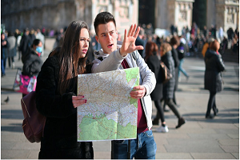
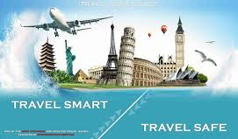
conclusion
An advanced intelligent tourist guide has the potential to transform the way we travel.

